Slide 1


Diabetes Awareness
NOV 2021
PREDICTING DIABETES
Presented By:
Sultanah Aldossari
Rawan Alharbi

Slide 2



Introduction
CONTENT OUTLINE
Dataset
Expolarity Data Analysis
Data Pre-processing
Model Building and Evaluation
Conclusion

Slide 3


PROBLEM STATEMENT
Diabetes is a common chronic disease and poses a great threat to human health.
It can lead to chronic damage and dysfunction of various tissues. Therefore, The earlier diagnosis is obtained, the much easier we can control diabetes.
Our aim is to predict diabetes using Classification techniques.

Slide 4

DATASET
Pregnancies
Glucose
Blood Pressure
Skin Thickness
Insulin
BMI
Diabetes Pedigree Function
Age
Outcome

Slide 5



TOOLS

Slide 6

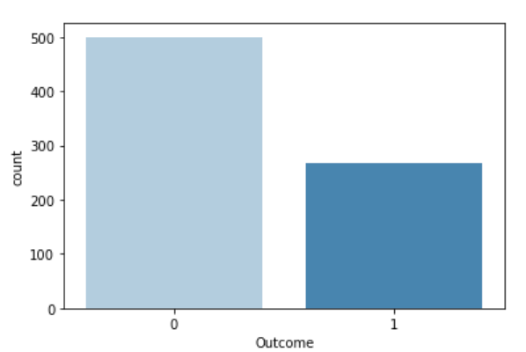
EXPOLARITY DATA ANALYSIS

Slide 7
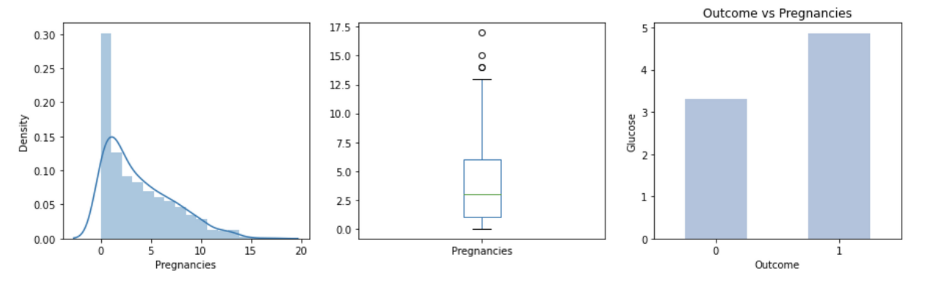
EXPOLARITY DATA ANALYSIS

Slide 8
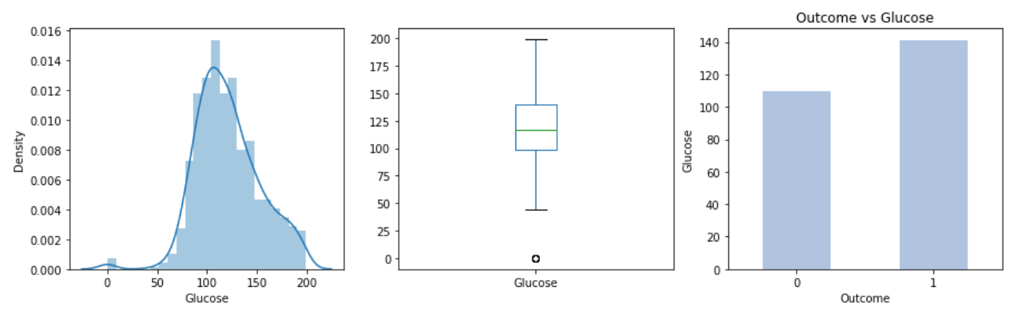
EXPOLARITY DATA ANALYSIS

Slide 9
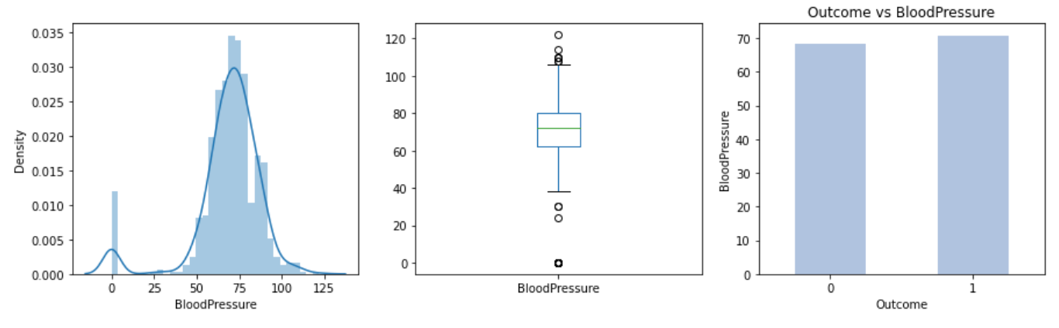
EXPOLARITY DATA ANALYSIS

Slide 10
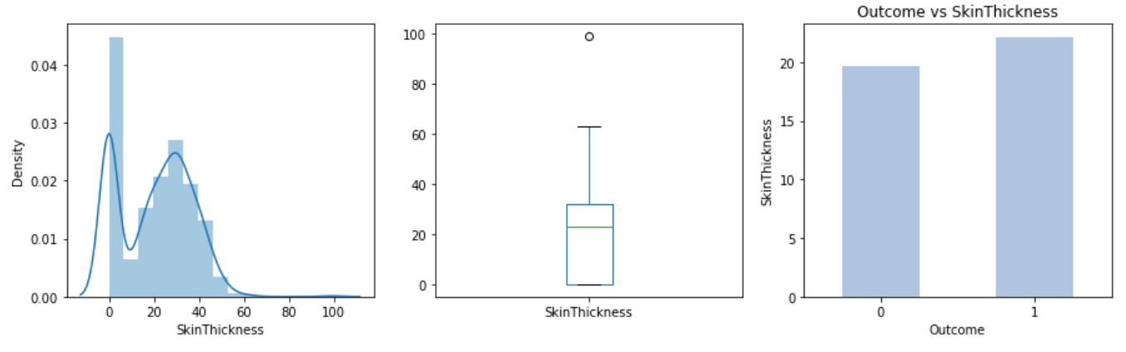
EXPOLARITY DATA ANALYSIS

Slide 11
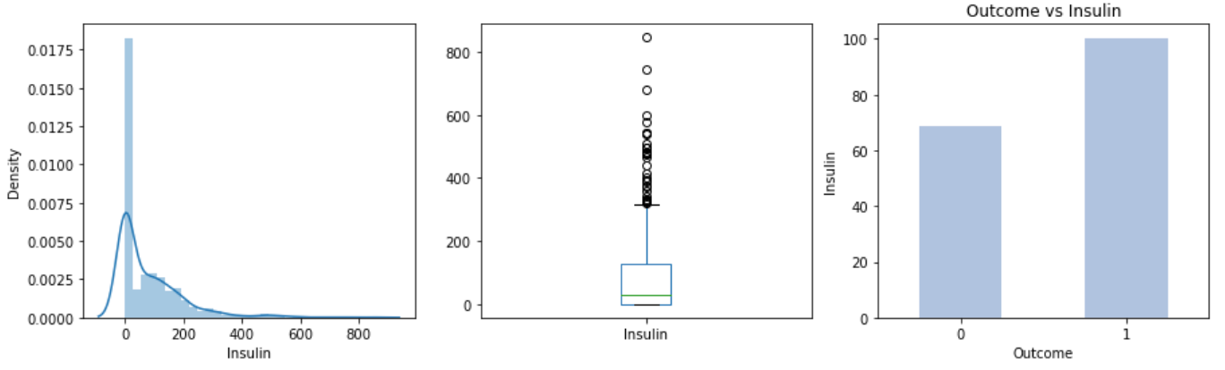
EXPOLARITY DATA ANALYSIS

Slide 12
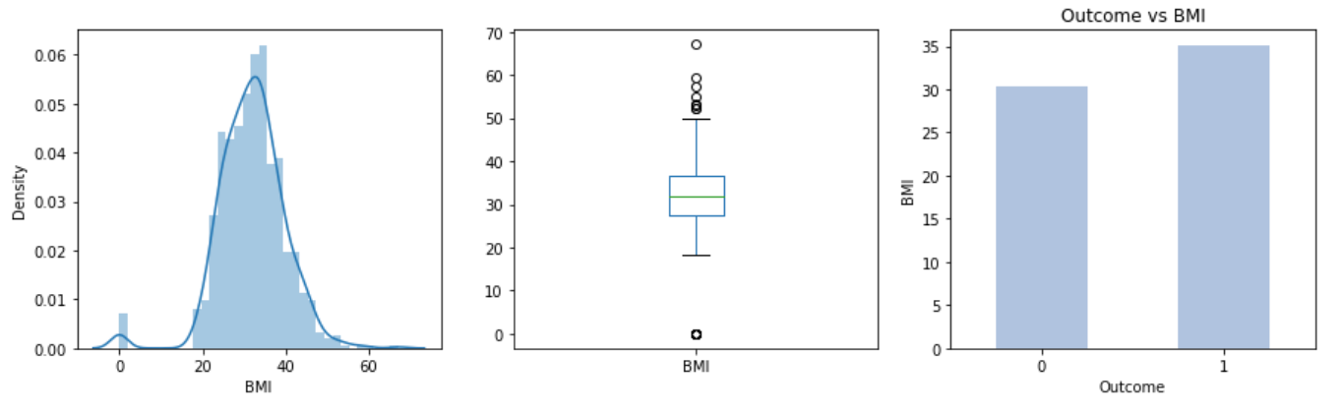
EXPOLARITY DATA ANALYSIS

Slide 13
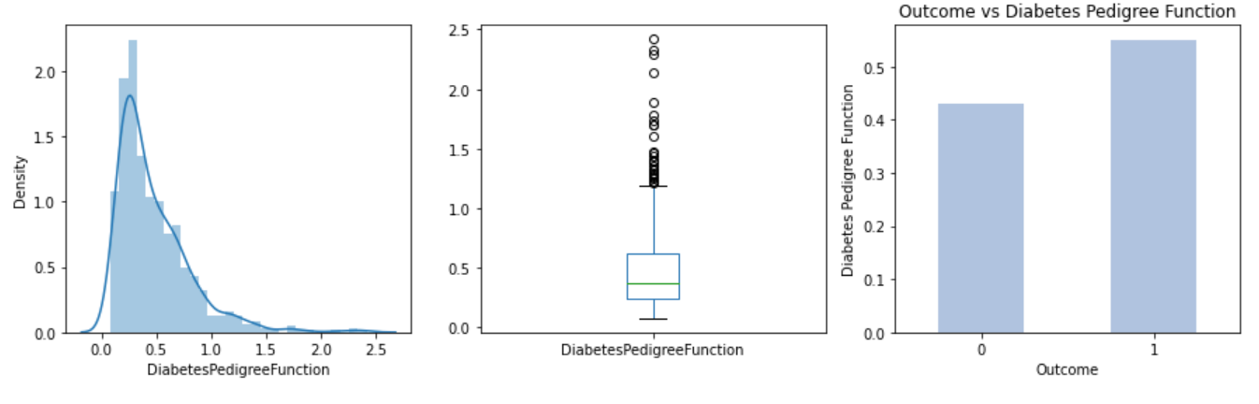
EXPOLARITY DATA ANALYSIS

Slide 14
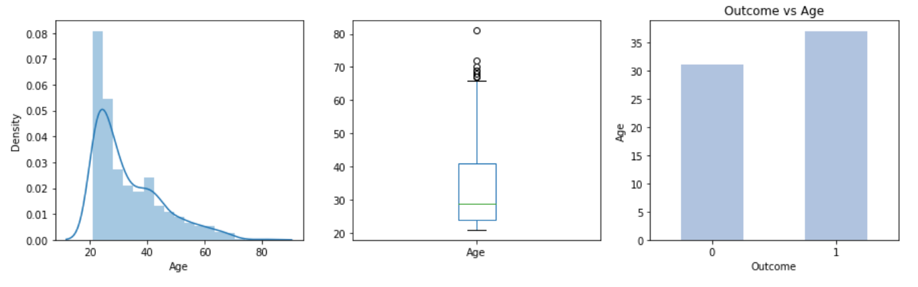
EXPOLARITY DATA ANALYSIS

Slide 15
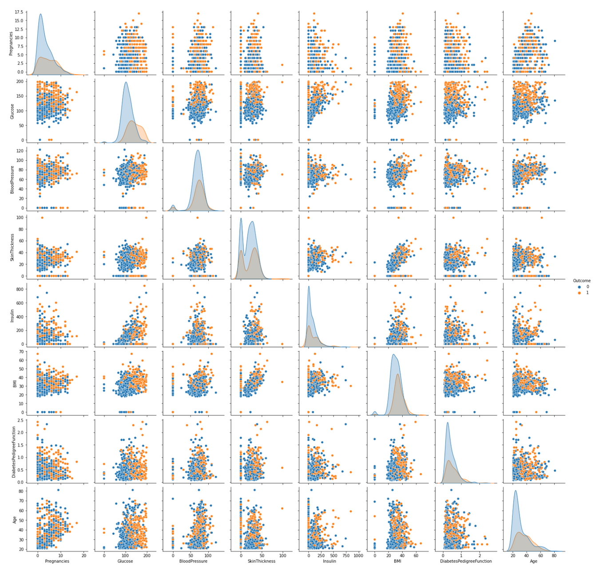
CONT: EDA
Relationship between target and predictors

Slide 16

DATA PRE-PROCESSING
Split into Train and Test
Outliers Handling
Handle Zeros
Scaling Data

Slide 17

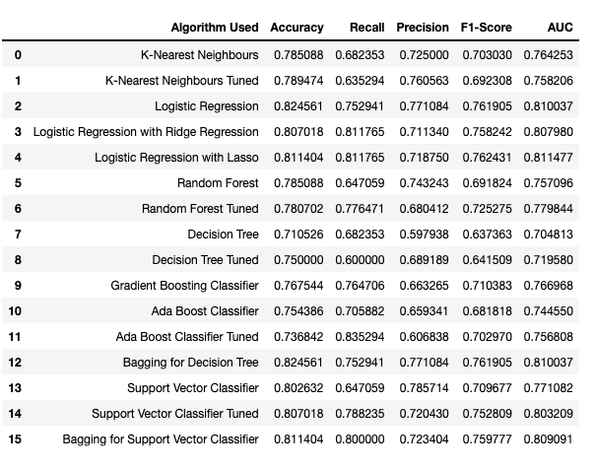
MODEL
EXPERIMENTS:

Slide 18
MODEL
SELECTION:

Slide 19
Ada Boost
Recall = 84%
AUC = 76%
BEST PREFORMED ALGORITHM:
Logistic Regression L2
Recall = 81%
AUC = 80%
Logistic Regression L1
Recall = 81%
AUC = 81%

Slide 20
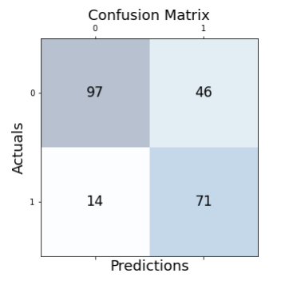
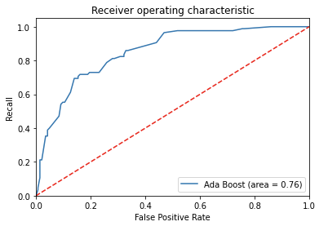
ADA BOOST CLASSIFIER
Confusion matrix & ROC Curve Plot

Slide 21
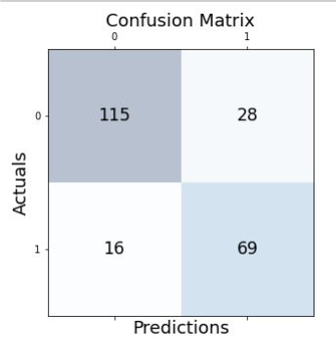
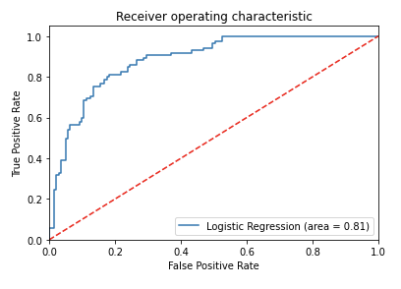
LOGISTIC REGRESSION L2:
Confusion matrix & ROC Curve Plot

Slide 22
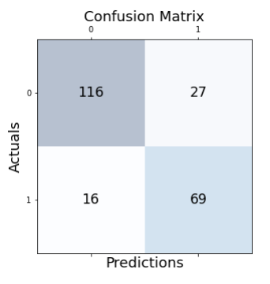
LOGISTIC REGRESSION L1
Confusion matrix & ROC Curve Plot

Slide 23
DIABETES PREDICTION APP

Slide 24



FUTURE WORK
Collect more data about diabetes and analyze them
Build a system that helps people in getting an initial information
For better predictions

Slide 25
CONCLUSION

Slide 26

DIABETES
THANK YOU FOR LISTENING!

